Slide 1
IE 440
PROCESS IMPROVEMENT
THROUGH PLANNED EXPERIMENTATION
IE 406
Simulation
Presenting Data in Tables
and Charts
Dr. Xueping Li
University of Tennessee
© 2003 Prentice-Hall, Inc.

Slide 2
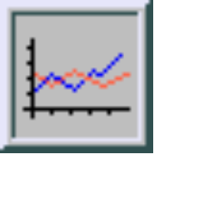
Chapter Topics
Organizing Numerical Data
  The Ordered Array and Stem-Leaf Display
Tabulating and Graphing Univariate Numerical Data
  Frequency Distributions: Tables, Histograms, Polygons
  Cumulative Distributions: Tables, the Ogive
Graphing Bivariate Numerical Data
© 2003 Prentice-Hall, Inc.

Slide 3
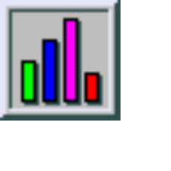
Chapter Topics
(continued)
Tabulating and Graphing Univariate Categorical Data
  The Summary Table
  Bar and Pie Charts, the Pareto Diagram
Tabulating and Graphing Bivariate Categorical Data
  Contingency Tables
  Side by Side Bar Charts
Graphical Excellence and Common Errors in Presenting Data
© 2003 Prentice-Hall, Inc.

Slide 4

Organizing Numerical Data
Numerical Data
41, 24, 32, 26, 27, 27, 30, 24, 38, 21
Frequency Distributions
Cumulative Distributions
Ordered Array
21, 24, 24, 26, 27, 27, 30, 32, 38, 41
2 144677
3 028
4 1
Histograms
Ogive
Stem and Leaf
Display
Tables
Polygons
© 2003 Prentice-Hall, Inc.

Slide 5

Organizing Numerical Data
(continued)
Data in Raw Form (as Collected):
24, 26, 24, 21, 27, 27, 30, 41, 32, 38
Data in Ordered Array from Smallest to Largest:
21, 24, 24, 26, 27, 27, 30, 32, 38, 41
Stem-and-Leaf Display:
2 1 4 4 6 7 7
3 0 2 8
4 1
© 2003 Prentice-Hall, Inc.

Slide 6
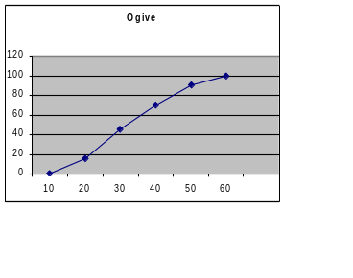
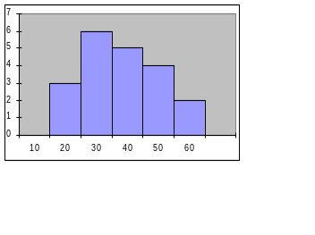
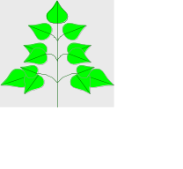
Tabulating and Graphing Numerical Data
Numerical Data
41, 24, 32, 26, 27, 27, 30, 24, 38, 21
Frequency Distributions
Cumulative Distributions
Ordered Array
21, 24, 24, 26, 27, 27, 30, 32, 38, 41
2 144677
3 028
4 1
Histograms
Ogive
Stem and Leaf
Display
Tables
Polygons
© 2003 Prentice-Hall, Inc.

Slide 7
Tabulating Numerical Data: Frequency Distributions
Sort Raw Data in Ascending Order
12, 13, 17, 21, 24, 24, 26, 27, 27, 30, 32, 35, 37, 38, 41, 43, 44, 46, 53, 58
Find Range: 58 - 12 = 46
Select Number of Classes: 5 (usually between 5 and 15)
Compute Class Interval (Width): 10 (46/5 then round up)
Determine Class Boundaries (Limits):10, 20, 30, 40, 50, 60
Compute Class Midpoints: 15, 25, 35, 45, 55
Count Observations & Assign to Classes
© 2003 Prentice-Hall, Inc.

Slide 8
Frequency Distributions, Relative Frequency Distributions and Percentage Distributions
Data in Ordered Array:
12, 13, 17, 21, 24, 24, 26, 27, 27, 30, 32, 35, 37, 38, 41, 43, 44, 46, 53, 58
Relative
Frequency
Percentage
Class Frequency
10 but under 20 3 .15 15
20 but under 30 6 .30 30
30 but under 40 5 .25 25
40 but under 50 4 .20 20
50 but under 60 2 .10 10
Total 20 1 100
© 2003 Prentice-Hall, Inc.

Slide 9
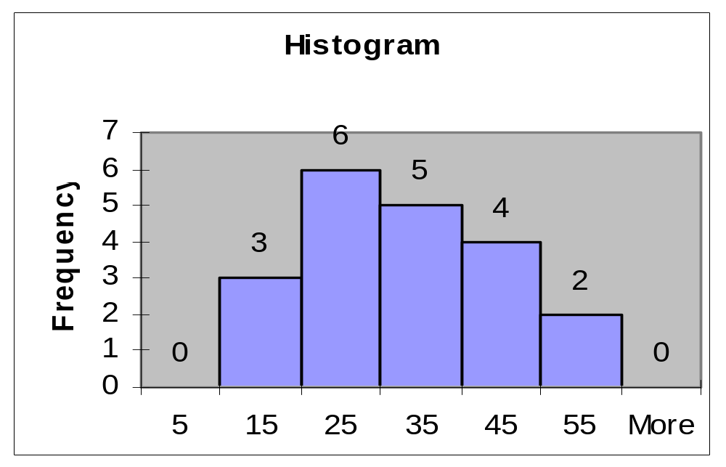
Graphing Numerical Data:
The Histogram
Data in Ordered Array:
12, 13, 17, 21, 24, 24, 26, 27, 27, 30, 32, 35, 37, 38, 41, 43, 44, 46, 53, 58
No Gaps Between Bars
Class Boundaries
Class Midpoints
© 2003 Prentice-Hall, Inc.

Slide 10
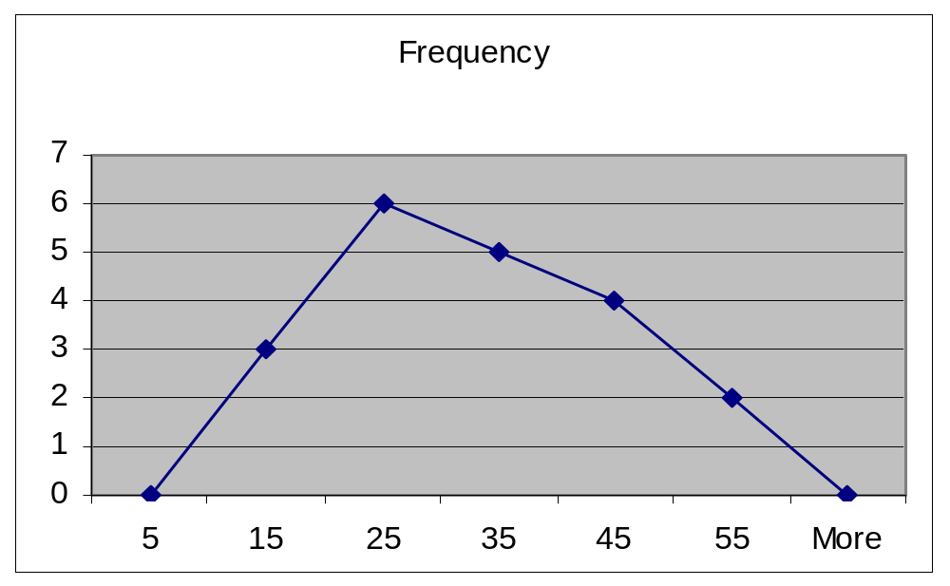
Graphing Numerical Data:
The Frequency Polygon
Data in Ordered Array:
12, 13, 17, 21, 24, 24, 26, 27, 27, 30, 32, 35, 37, 38, 41, 43, 44, 46, 53, 58
Class Midpoints
© 2003 Prentice-Hall, Inc.

Slide 11
Tabulating Numerical Data:
Cumulative Frequency
Data in Ordered Array:
12, 13, 17, 21, 24, 24, 26, 27, 27, 30, 32, 35, 37, 38, 41, 43, 44, 46, 53, 58
Lower Cumulative Cumulative
Limit Frequency % Frequency
10 0 0
20 3 15
30 9 45
40 14 70
50 18 90
60 20 100
© 2003 Prentice-Hall, Inc.

Slide 12
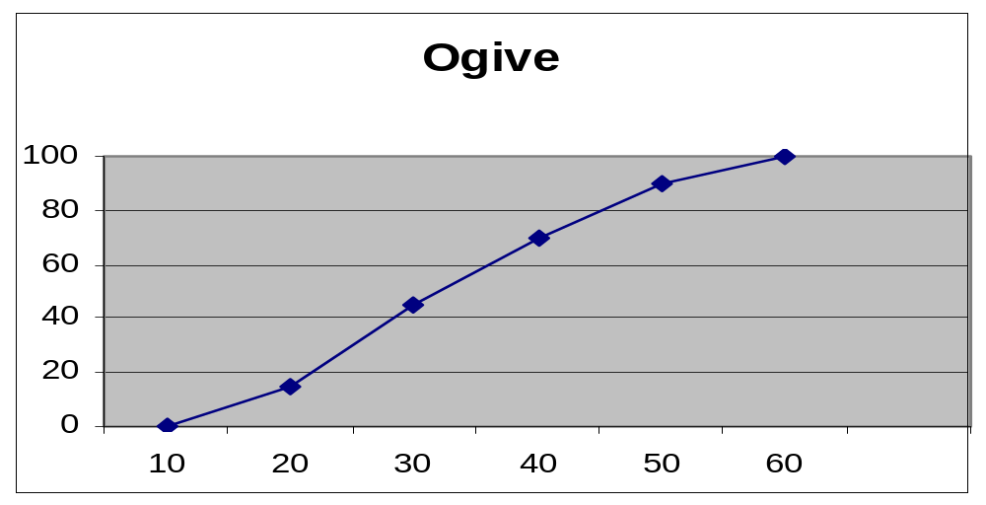
Graphing Numerical Data:
The Ogive (Cumulative % Polygon)
Data in Ordered Array :
12, 13, 17, 21, 24, 24, 26, 27, 27, 30, 32, 35, 37, 38, 41, 43, 44, 46, 53, 58
Class Boundaries (Not Midpoints)
© 2003 Prentice-Hall, Inc.

Slide 13
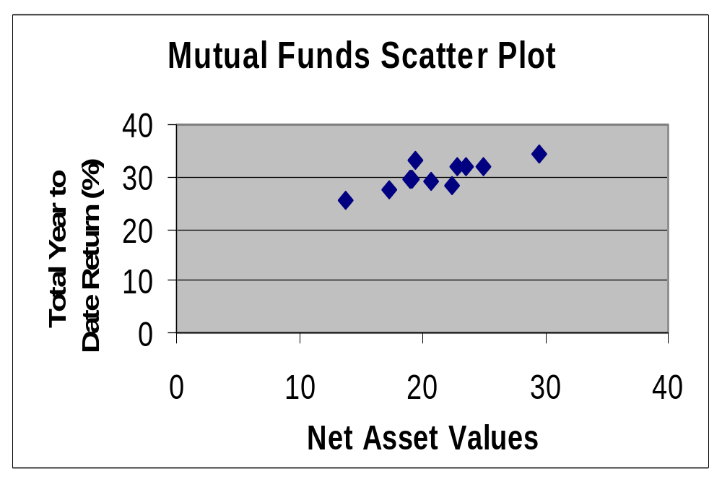
Graphing Bivariate Numerical Data (Scatter Plot)
© 2003 Prentice-Hall, Inc.

Slide 14
Tabulating and Graphing Univariate Categorical Data
Categorical Data
Graphing Data
Tabulating Data
The Summary Table
Pie Charts
Bar Charts
Pareto Diagram
© 2003 Prentice-Hall, Inc.

Slide 15
Summary Table
(for an Investor’s Portfolio)
Investment Category Amount Percentage
(in thousands $)
Stocks 46.5 42.27
Bonds 32 29.09
CD 15.5 14.09
Savings 16 14.55
Total 110 100
Variables are Categorical
© 2003 Prentice-Hall, Inc.

Slide 16
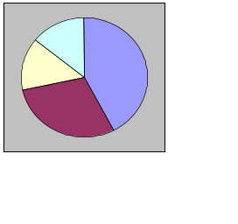
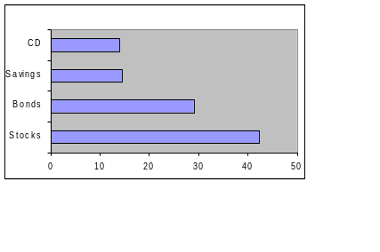
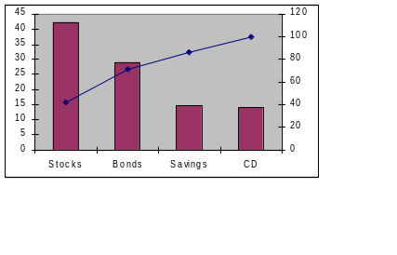
Graphing Univariate
Categorical Data
Categorical Data
Graphing Data
Tabulating Data
The Summary Table
Pie Charts
Bar Charts
Pareto Diagram
© 2003 Prentice-Hall, Inc.

Slide 17
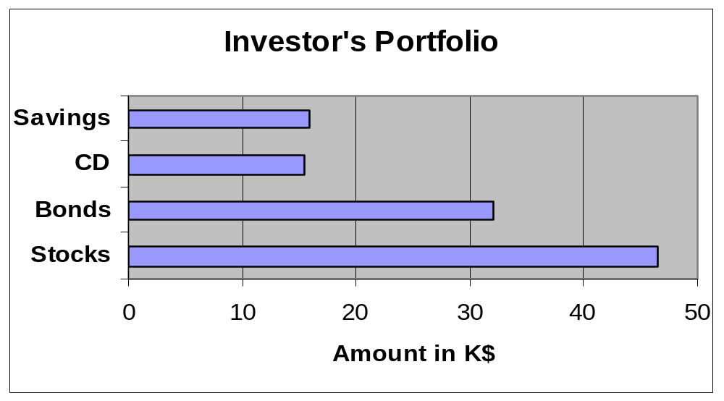
Bar Chart
(for an Investor’s Portfolio)
© 2003 Prentice-Hall, Inc.

Slide 18
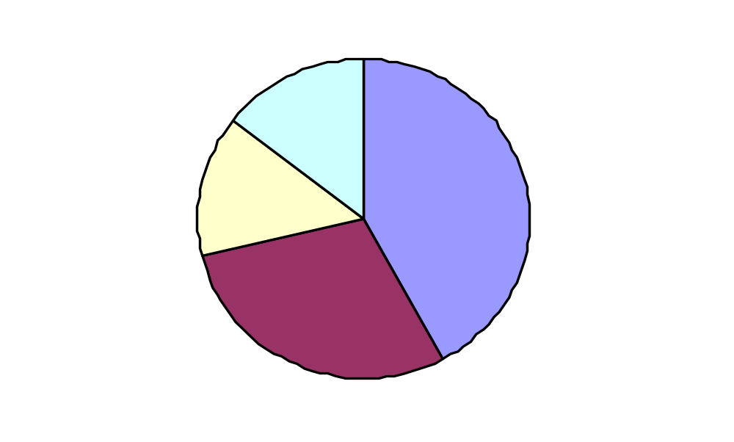
Pie Chart
(for an Investor’s Portfolio)
Amount Invested in K$
Savings
15%
Stocks
42%
CD 14%
Percentages are rounded to the nearest percent
Bonds 29%
© 2003 Prentice-Hall, Inc.

Slide 19
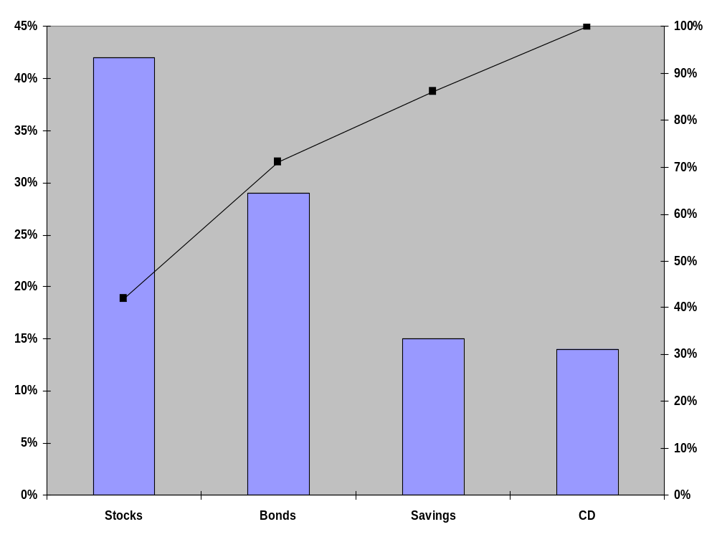
Pareto Diagram
Axis for bar chart shows % invested in each category
Axis for line graph shows cumulative % invested
© 2003 Prentice-Hall, Inc.

Slide 20
Tabulating and Graphing Bivariate Categorical Data
Contingency Tables: Investment in Thousands of Dollars
Investment Investor A Investor B Investor C Total Category
Stocks 46.5 55 27.5 129
Bonds 32 44 19 95
CD 15.5 20 13.5 49
Savings 16 28 7 51
Total 110 147 67 324
© 2003 Prentice-Hall, Inc.

Slide 21
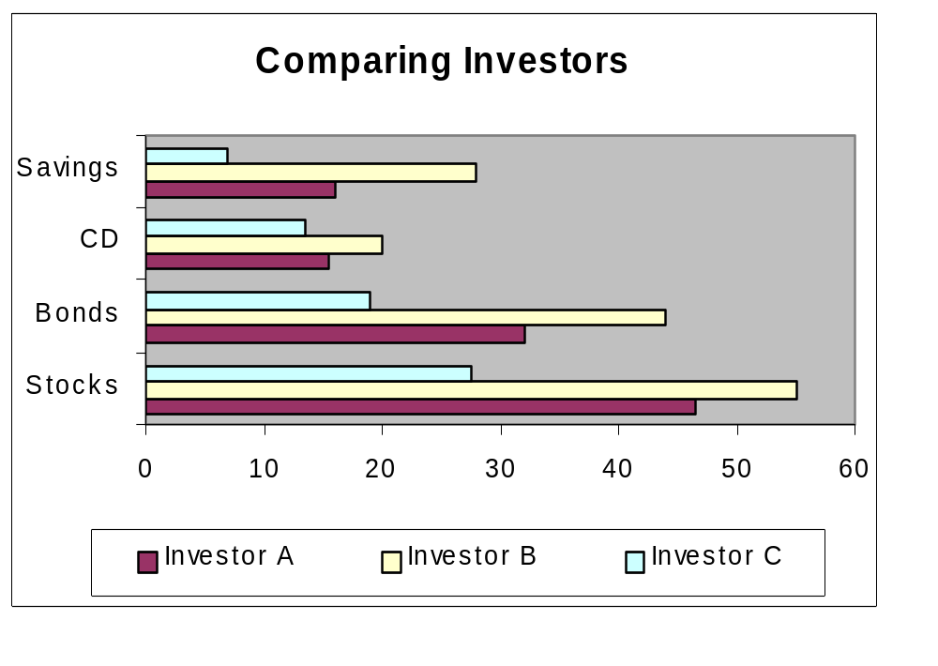
Tabulating and Graphing Bivariate Categorical Data
Side by Side Charts
© 2003 Prentice-Hall, Inc.

Slide 22
Principles of Graphical Excellence
Well-Designed Presentation of Data that Provides:
  Substance
  Statistics
  Design
Communicate Complex Ideas with Clarity, Precision and Efficiency
Gives the Largest Number of Ideas in the Most Efficient Manner
Almost Always Involves Several Dimensions
Telling the Truth about the Data
© 2003 Prentice-Hall, Inc.

Slide 23
Errors in Presenting Data
Using ‘Chart Junk’
No Relative Basis in Comparing Data between Groups
Compressing the Vertical Axis
No Zero Point on the Vertical Axis
© 2003 Prentice-Hall, Inc.

Slide 24
‘Chart Junk’
✓
Bad Presentation
Good Presentation
Minimum Wage
Minimum Wage
$
1960: $1.00
4
1970: $1.60
2
1980: $3.10
0
1990: $3.80
1960
1970
1980
1990
© 2003 Prentice-Hall, Inc.

Slide 25
No Relative Basis
Bad Presentation
✓
Good Presentation
A’s received by students
A’s received by students
Freq.
30
%
300
200
20
100
10
0
0
FR
SO
JR
SR
FR
SO
JR
SR
FR = Freshmen, SO = Sophomore, JR = Junior, SR = Senior
© 2003 Prentice-Hall, Inc.

Slide 26
Compressing Vertical Axis
✓
Bad Presentation
Good Presentation
Quarterly Sales
Quarterly Sales
$
$
200
50
100
25
0
0
Q1
Q2
Q3
Q4
Q1
Q2
Q3
Q4
© 2003 Prentice-Hall, Inc.

Slide 27
No Zero Point on Vertical Axis
Bad Presentation
✓
Good Presentation
Monthly Sales
Monthly Sales
$
$
45
45
42
42
39
39
36
36
J
F
M
A
M
J
0
J
F
M
A
M
J
Graphing the first six months of sales
© 2003 Prentice-Hall, Inc.

Slide 28
Chapter Summary
Organized Numerical Data
  The Ordered Array and Stem-Leaf Display
Tabulated and Graphed Univariate Numerical Data
  Frequency Distributions: Tables, Histograms, Polygons
  Cumulative Distributions: Tables, the Ogive
Graphed Bivariate Numerical Data
© 2003 Prentice-Hall, Inc.

Slide 29
Chapter Summary
(continued)
Tabulated and Graphed Univariate Categorical Data
  The Summary Table
  Bar and Pie Charts, the Pareto Diagram
Tabulated and Graphed Bivariate Categorical Data
  Contingency Tables
  Side by Side Charts
Discussed Graphical Excellence and Common Errors in Presenting Data
© 2003 Prentice-Hall, Inc.

